Slide 1
Life in the year.
Adela Todorová
5.A

Slide 2
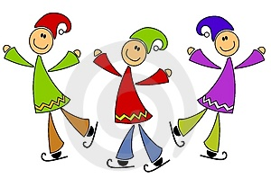
January
In January me and my family celebrate a New Year.
A New Year is very nice.
I like white snow and I wear warm clothes.
In January children build snowmen
I go iceskating.
In January I and my mum always go sledging.
January is not my favourite month.

Slide 3
February
February is the short month.
In February we celebrate mum´s birthday.
We have winter holiday and I am with my grandma and grandpa.
On fourteenth of February is Valentine´s Day.
I like this day because I usually get red rose and sweet chocolate.
I LIKE FEBRUARY!!!

Slide 4
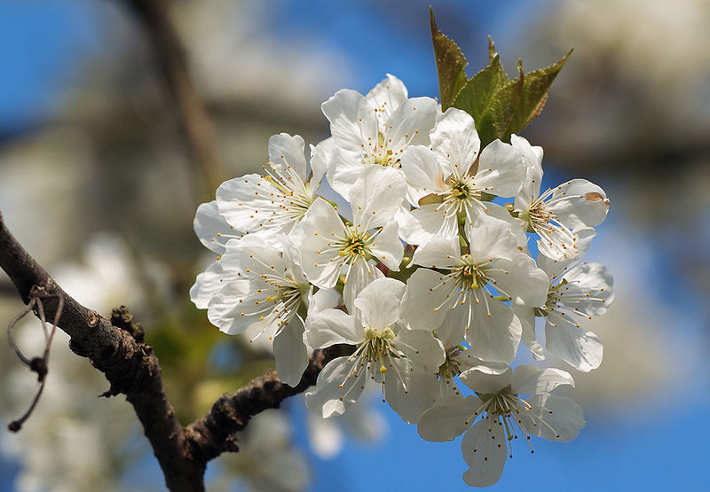
March
In March is spring and I like Spring.
In Spring I can see the first flowers and birds.
I wear skirts and T-shirts.
I go cycling on my new bicycle and walk with my dog.

Slide 5
April
In April I am looking for Easter bunnys and chocolates.
We celebrate Easter day.
I cut the grass in the grandma´s garden.
I plant carrots, potatoes, tomatoes in the garden.

Slide 6
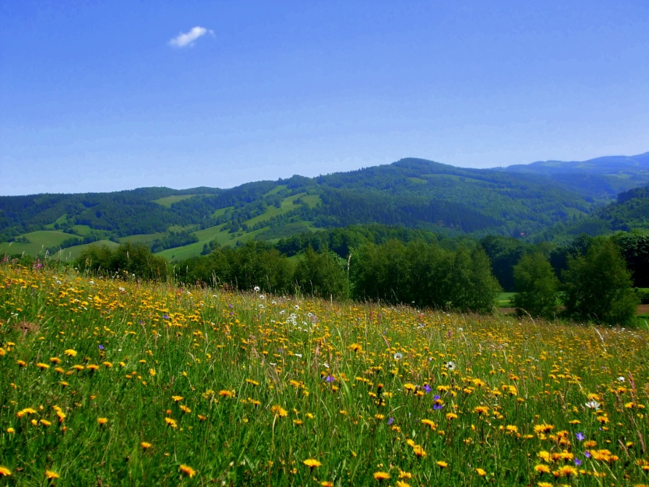
May
In May I can collect red strawberries and cherries.
I usually play with a ball in grandpa´s garden.
The weather is hot and I wear T-shirt and shorts.
I collect flowers and cut grass.
In May I sometimes visit ZOO.

Slide 7
June
June is the last month of school year.
I write a lot of tests.
I go for horse races and my mum always buys me popcorn.
We go for icecream.
I always buy lemon and chocolate icecreams.
I have got a certificate from school and I am happy.

Slide 8
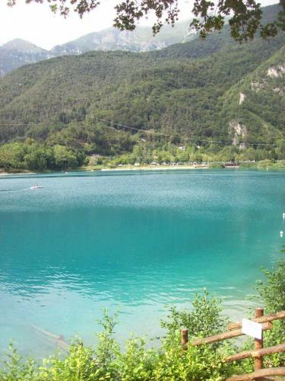
July
In the first of July is my birthday. I have a Summer Holiday. I like it.
I don´t learn but I sometimes read a book.
I usually visit my father who lives in Germany.
I go to camp with my best friend.
I can swim in the swimming pool.
I LIKE SUMMER HOLIDAYS !!!

Slide 9
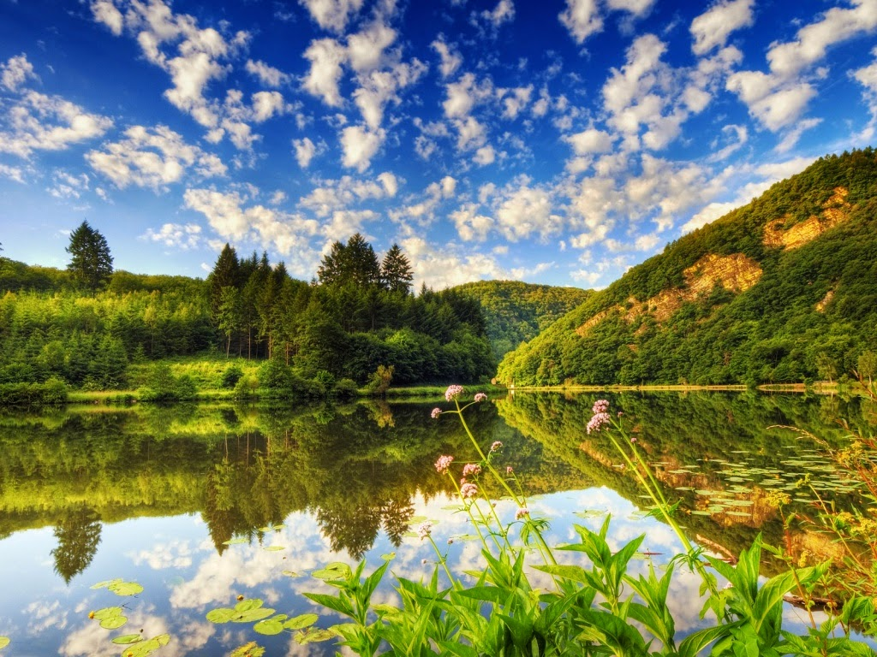
August
In August my father has got a birthday.
I often visit my family in other cities.
I travel by car to Croatia.
I can swim in the sea every day.
I can see a lot of fireworks there.
Every evening I walk to the shops.
August is the last month our holiday.
Goodbye holiday.

Slide 10
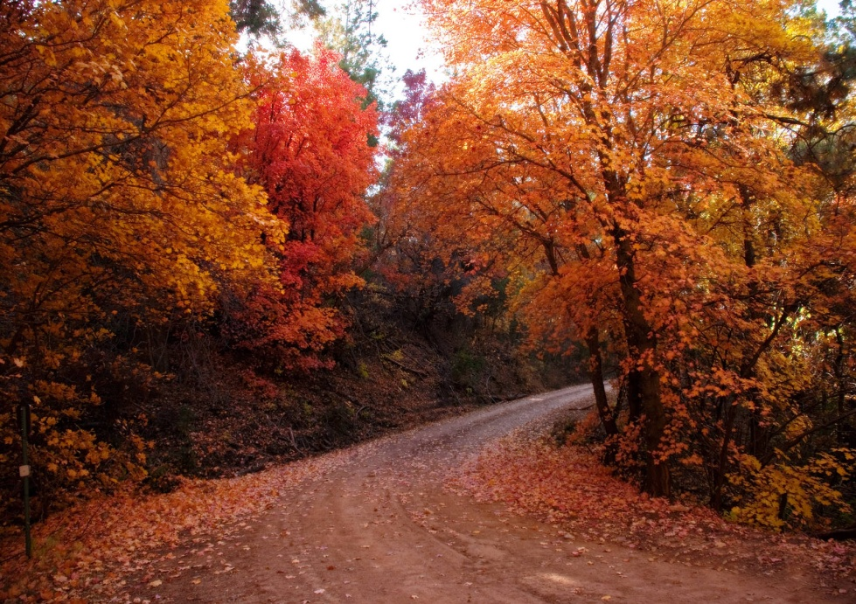
September
In September new school year starts.
I have got many new books.
I learn for school.
In September leaves fall from the trees.
I wear jackets and long trousers.
My cousin celebrates birthday.
I like autunum.

Slide 11
October
October is the tenth month of the year.
The weather is very cold and it is rainy weather. I have got an umbrella.
In October my grandpa celebrates birthday.
We go with my cousin for the lunch.
I like October because, I play with my young cousin.
We make a kite.

Slide 12
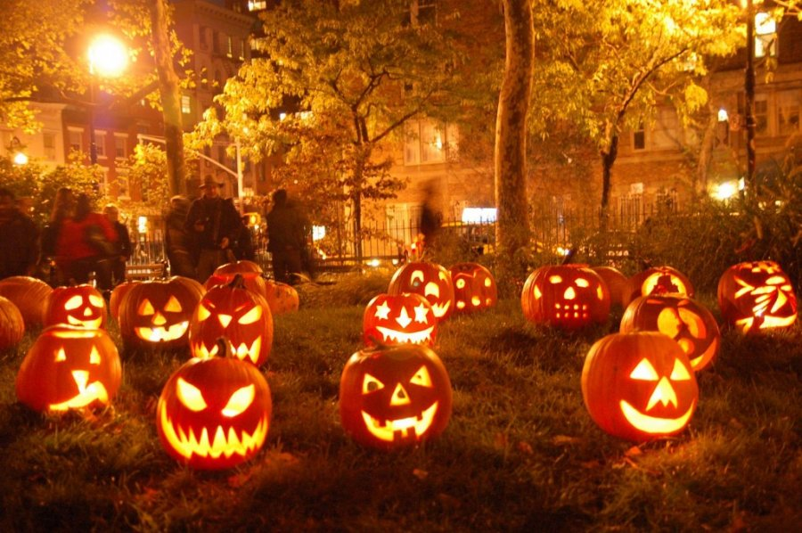
November
In November is cold but I wear warm clothes.
My dog has got the first birthday.
We celebrate my favourite holiday HALLOWEEN.
In Halloween I get a lot of sweets. I sometimes carve pumpkins.
On second of November is All Saints´ Day. We have got candles at home and visit cemeteries.

Slide 13
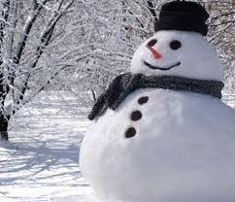
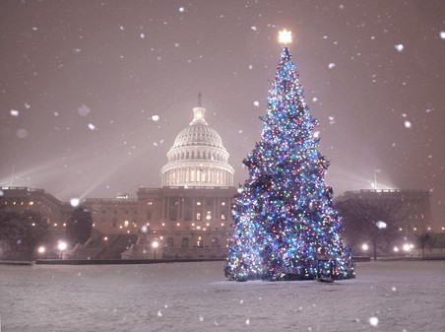
December
In December is CHRISTMAS. It is on the twenty-four of December. We are together with all my family.
I get many presents. I decorate Christmas tree at home. I usually bake cakes with my mum. On twenty-second of December is my name´s day. It is snow and I like skating, skiing and sledging.

